Slide 1
STADV
Nicole Jacobs, CEO
Standing Together Against Domestic Violence
05/06/2017

Slide 2
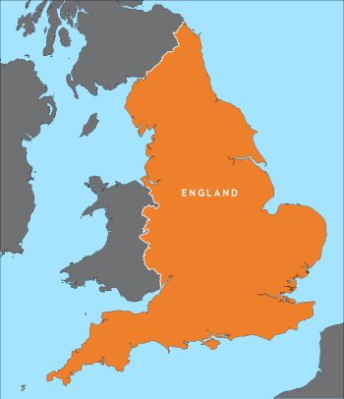
London, UK and the Tri-Boroughs

Slide 3
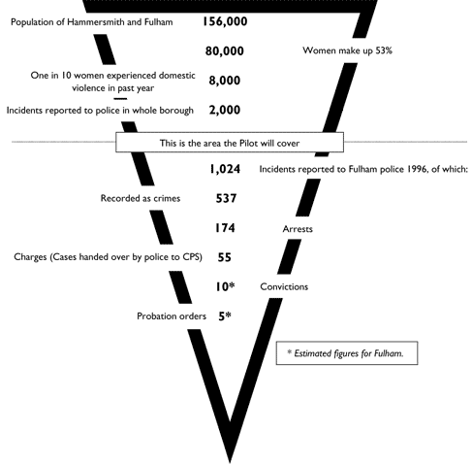
First a little about STADV
How Standing Together started in the late 1990’s
1996 Figures

Slide 4
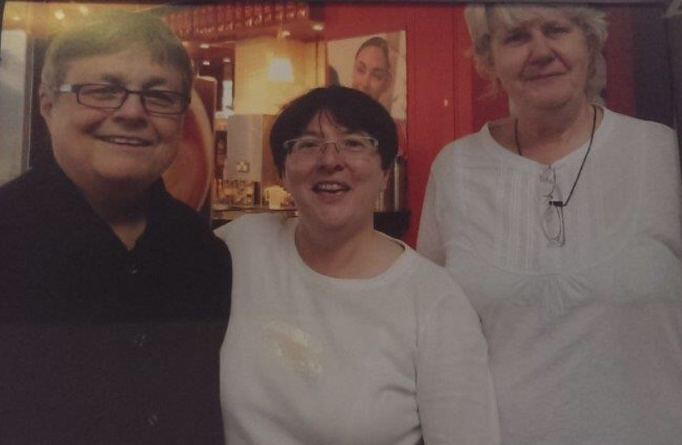
Ellen Pence our LBHF Cllr Lisa Holman in 1997
Ellen on one of her last visits with our founders Beryl Foster and Bear Montique

Slide 5
Innovations in Coordination:

Slide 6
The Coordinated Community Response
National Health Alliance
DAHA- national housing
Training s Consultancy s DHRs s Survivor Consultation
DVCN- domestic violence coordinators network

Slide 7
What is a Coordinated Community Response?
CCR started as Domestic Violence model and we are adapting it to VAWG.
Every agency who has a responsibility for dealing with victims of violence [against women and girls], their children or perpetrators, must work effectively within their own agency And with all the other agencies who also have that responsibility in order to secure the safety of the victim and their children and hold perpetrators to account. The process by which this work is integrated and managed is known as the CCR.
The broadest response - addressing risk and need:
Prevention
Early Intervention
Dealing with Crisis and Risk fluctuation
Long term recovery and Safety
Notes:
The CCR enables a whole system response to a whole person, recognising the wellbeing and safety needs of victims and survivors, with communities and organisations working alongside them.
Responsibility for safety should not rest solely with individual victims but also with the community and services.
Perpetrators must be held to account for the harm they inflict, and offered routes to change their abusive behaviours.
A CCR supports organisational responses, it does not replace them: organisations remain responsible and accountable (to victims, to their own agencies and to the partnership) for their own responses to domestic abuse, within a context of multi-agency working.
A CCR requires leadership, a shared understanding of domestic abuse and risk, and coordination (including: agencies understand their role in the CCR and the role of partner agencies).
Strategy + Governance + Services
All link up and work to a single vision of to promote a co-ordinated, multi-agency community response to domestic violence. This approach recognises that no one agency can tackle domestic violence effectively if acting alone. Without effective coordination of activities between agencies, responses are less effective and survivors of domestic violence are still at risk of falling through the gaps in the system.
The coordinated partnership model enables all the relevant agencies to identify and respond successfully to domestic violence. We work together with statutory and community organisations - from criminal justice agencies to children’s services and refuges - to ensure that victims and children are safer, and perpetrators are held to account.
The criminal justice system is just one aspect of a fully functioning coordinated approach, particularly when only a small number of victims report to the police and only a percentage of these cases will carry through into court. Health, Children’s Services, schools, faith groups, family, friends, work colleagues, and the plethora of voluntary agencies which support individuals and families, all have an important role to play in the response to domestic violence. No one agency can respond effectively on its own. Our success depends on the relationships and partnerships we build.
The core purpose of developing coordinated responses is to enable individuals and communities to live free of violence and abuse. This approach seeks to eliminate domestic violence through improving integrated working, through written procedures, policies, shared action plans and resources, all supporting professional interventions. We take survivor safety very seriously; this must be integrated into all aspects of planning and delivery. In addition we believe that challenging social attitudes that normalise or minimise abuse are crucial in supporting prevention and early intervention work.
Our approach acknowledges that the onus of holding perpetrators accountable lies with service providers, and the wider community, rather than the survivor. While each agency maintains its independence, all agencies involved must work in an integrated and coordinated way to achieve the following:
• An increase in the safety of domestic violence survivors
• An increase in the safety of children who live with domestic violence
• Holding perpetrators accountable for their actions
• Effective prevention strategies.

Slide 8
Core Values of the CCR:
Collaboration
Connected with gender inequality
Individual experiences
Whole system/ whole person
Responsibility for safety rests with systems and community
Perpetrators held accountable
Support organisational response- not to replace it
Shared understanding, shared leadership

Slide 9
Accountability Five Ways (from EP 2009)
Holding agencies accountable to other agencies
Holing practitioners accountable to other interveners in the system
Holding offenders to account for the harm they have done
Holding practitioners to account for the safely and wellbeing of survivors
Holding practitioners to account for the due process of offenders

Slide 10
Pillars of our CCR:
Shared Belief and Commitment
Strategy
Structure
Representation
Resources
Coordination
Training
Research/Data
Policies/Protocols and Processes
Specialist Services
Diversity
Survivors’ voices

Slide 11
Who is involved?
Statutory/Government Sector
Non-Profit Sector
Family Services
Criminal Justice System
Education
Housing – local homelessness service and the organisations that provide housing
Health Services
Adult Services
Mental Health
Substance Misuse Services
Civil Justice
Community Safety
Strategic Boards (ie LSCB)
Frontline services for survivors of abuse
IDVA- Independent Domestic Violence Advisors, Shelters, Support for young people, Outreach, Rape Crisis, sexual violence services (forensic)
Community and Faith organisations
Benefits advice agencies
Survivor
Children
Perpetrator
Community: Friends, Family, Neighbours, Colleagues (non abusive community members)
Notes:
Better question is – Who ISN’T?

Slide 12
The Tri-Borough CCR structure:
VAWG Partnership and Governance Structure
VAWG Strategy/Action Plan (2015-18)
VAWG Commissioning: Coordination AND Frontline services for survivors and their families

Slide 13
Our 7 Strategic Aims
In short we aspire to ‘Get it Right. First Time, Every Time.’
Access
Response
Community
Practitioners
Children and Young People
Perpetrators
Justice and Protection
Notes:
VAWG vs Domestic Abuse
Keep survivors, children and perpetrators at the centre
Inclusivity of approach: Age, race, sexual orientation, socio economic status, disability, gender
Safeguarding: Both adults and children ( raise strategic profile)
Build on success of sovereign borough partnerships
Embed learning from Process of Consultation:
Needs assessment, Ongoing Stakeholder engagement, Commissioning Consultation with Third sector and VAWG survivors

Slide 14
Community Safety Partnership
Safeguarding Adults Board
Safeguarding
Children Board
Tri-Borough VAWG Strategic Board
(Director-level, Senior Officers, CEOs, Operational Group Chairs)
Modern Slavery /
Exploitation
Harmful Practices
Risk & Review
Specialist Services
Children & Health
Housing
Tri-Borough VAWG Partnership Structure

Slide 15
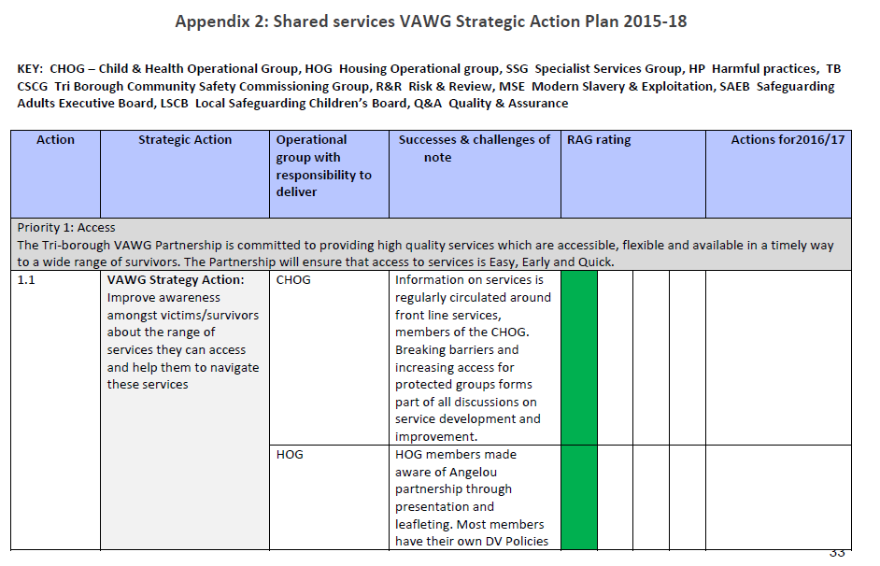

Slide 16
VAWG Commissioning
Shift to outcomes focused commissioning, both for frontline services and coordination = CCR!
Collaborative approach in service design.
Focus on victims/survivors, their experiences and their needs.
Integration with wider commissioning processes and services.

Slide 17
Frontline Service Innovation:
The Angelou Partnership – a local consortium of specialist VAWG Services
Perpetrator Pilot
Harmful Practices Pilot
Large-scale training/investment in staff
Data collection to evidence success/chart progress against Strategies
Campaigns ie Blooming Strong and #Speaksense
9 Shelters
‘Ask Me
Accommodation based support for women existing prostitution and trafficking
Ongoing Survivor Consultation
VAWG Events Calendar: Conferences and Community Engagement and Awareness Raising Activities
Notes:
Add or take out as necessary depending on audience

Slide 18
Outcomes and Outputs 2015/16
7500 women supported
2000+ professionals trained in VAWG
MARACs (high risk panels) heard 770 cases; highest number of LGBT cases in the country
250% increase in reporting of FGM cases
10-20% annual increase in reports of VAWG crimes to police
87% of women reporting increased feelings of safety
89% reporting decrease in abuse due to support
81% reporting improved quality of life
72.5% of DV defendants convicted across specialist DA courts

Slide 19
DHR lessons: Examples of what happened when we do not have a CCR
Individual to local area and linked to action plans
Overarching themes are:
Risk
Record keeping
Public awareness
Training
Mental health and substance misuse
Policy and joint working protocols

Slide 20
“Just take stock from time to time, and refresh the core aims and values which make this organisation so special. Listen to the voices of survivors, they will not be all saying the same thing but it is remarkable how consistent those voices have been over the years”
Ellen Pence

Slide 21
For more information, please contact:
Nicole Jacobs
n.jacobs@standingtogether.org.uk
+447810524096

